Slide 1









Decimate Dengue: The Pre-Summit Webinars (3rd Webinar Series)
IMPACT OF THE COVID-19 PANDEMIC ON THE GLOBAL DENGUE SITUATION
March 24, 2021
8pm – 9.30pm (SGT)
Co-convenors:
Supported by:
Supported with unrestricted educational grants from Takeda Pharmaceutical Co Ltd. and Fondation Merieux.

Slide 2
Discussion points:
Has dengue cases gone up or down?
How has the pandemic affect efforts on vector control, education, studies and vaccination hesitancy

Slide 3
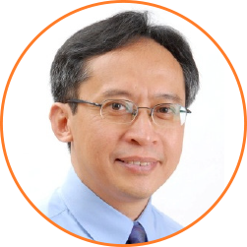
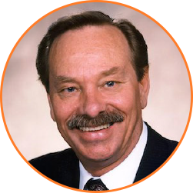


Speakers
CO-CHAIRPERSON:
Prof Duane J Gubler
Professor and Founding Director
Signature Research Programme in Emerging Infectious Disease
Duke-NUS Graduate Medical School, Singapore
Prof Zulkifli Ismail
Clinical Professor,
KPJ Healthcare University College, Malaysia
SPEAKERS:
Dr Ng Lee Ching
Director, National Environment Agency’s Environmental Health Institute, Singapore
Dr Hasitha Tissera
Specialist Medical Epidemiologist,
Ministry of Health, Sri Lanka

